Slide 1
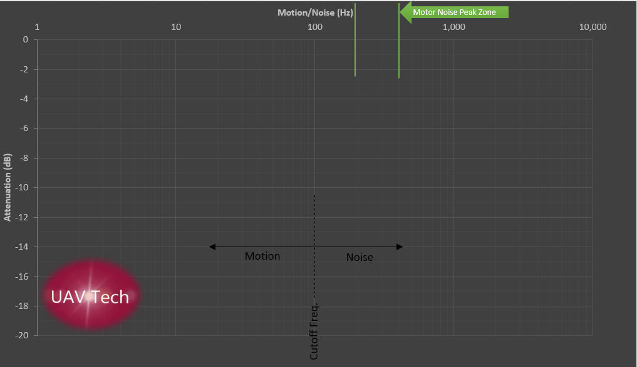
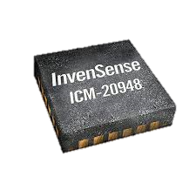
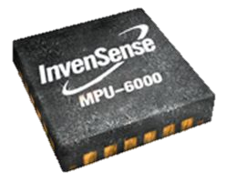
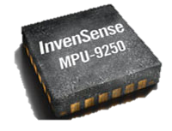
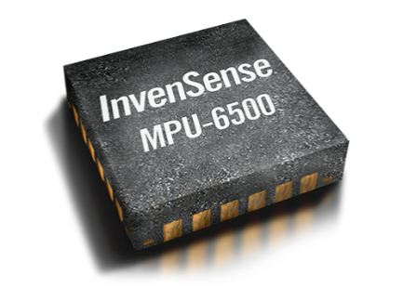
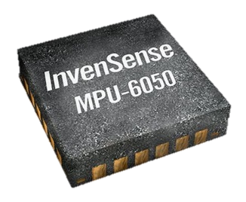
8k OR 32k Mode
8k Mode ONLY
Gyro DLPF (for 8k mode)
Gyro DLPF (for 32k mode)

Slide 2
Gyro 32k Mode
`
Cuts amplitude by 0.71
-3dB
Cuts amplitude by 0.5
500hz
3,000hz
Decade
Cuts amplitude by 0.1
Octave = current freq. x 2
Gyro DLPF
Stage 2 (BQRCF2 / FKF)
Stage 1 LPF (PT1)
Dynamic Notch
(cut = -30 to -40dB)

Slide 3

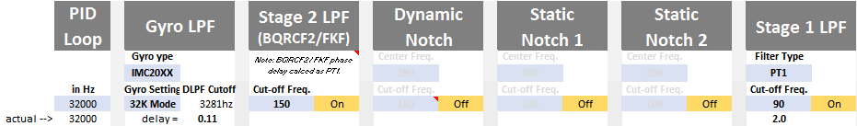
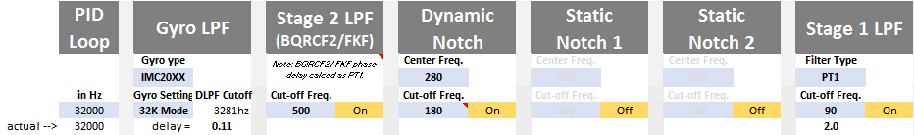



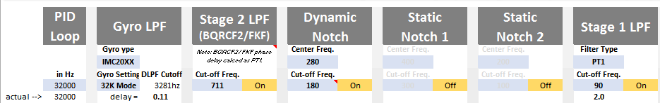

32k / 32k
Approach #1 - Start
Approach #2 - Start
Approach #1 - Optim.
Pro – Lower CPU utilization (req. overclocking)
Con – Lower peak motor noise attenuation
Approach #2 - Optim.
Pro – More peak motor noise attenuation
Con – Higher CPU utilization
(Note: this is the Betterflight recommendation)

Slide 4
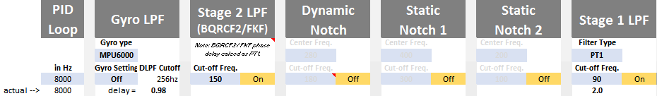

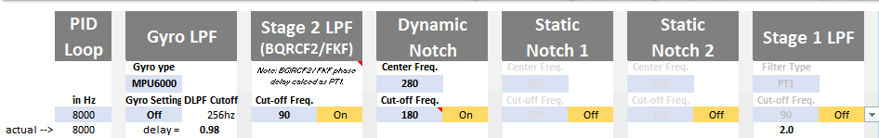


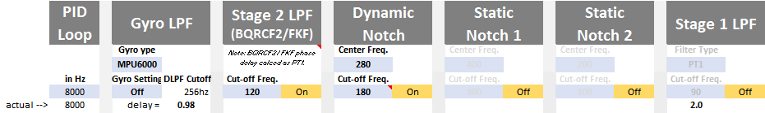
8k / 8k
Approach #1 - Start
Approach #2 - Start
Approach #1 - Optim.
Pro – Lower CPU utilization (req. overclocking)
Con – Lower peak motor noise attenuation
Approach #2 - Optim.
Pro – More peak motor noise attenuation
Con – Higher CPU utilization
(Note: this is the Betterflight recommendation)

Slide 5

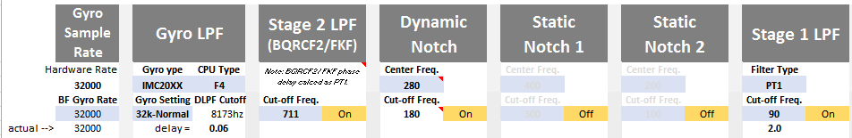

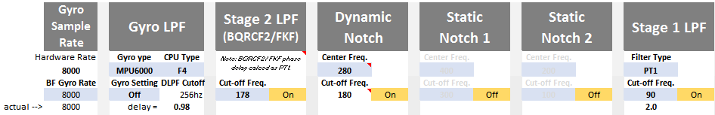

ButterFlight
At 32k
At 8k

Slide 6
Gyro 8k Mode
Gyro 32k Mode
`
-3dB
Gyro DLPF
Lowpass2 (PT1)
Lowpass1 (PT1)
Dynamic Notch
(cut = -30 to -40dB)

Slide 7
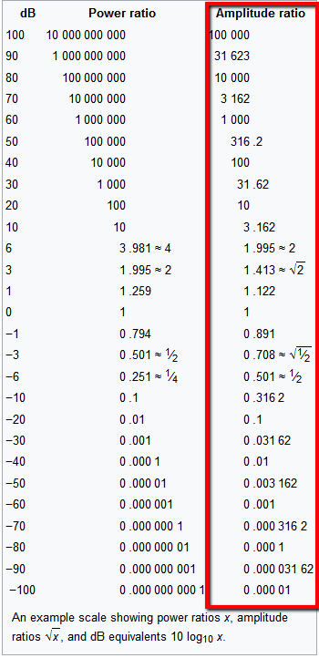

Slide 8
-3dB
Lowpass2
Lowpass1

Slide 9
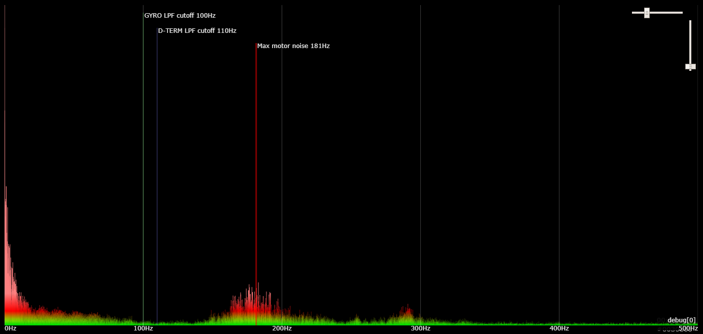
CLASSIC NOTCH
General Peak Motor Noise Range
Center low limit
Center high limit
Default = 100hz
240hz
130hz
500hz
Gen. Center = 280hz
Cutoff low limit
Cutoff high limit
Gen. Cuts -30 to -40db
(0.032 to 0.01 x amplitude)
120hz
200hz

Slide 10
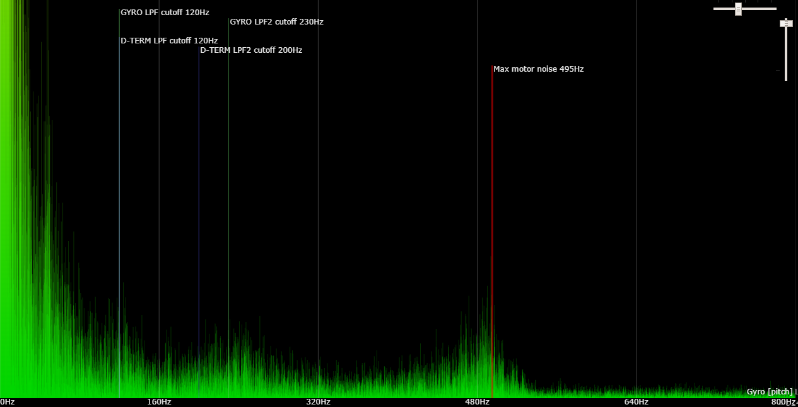
NEW NOTCH (BF 3.5+)
General Peak Motor Noise Range
Center low limit
Center high limit
Default = % OF CTR FREQ
125hz
666hz
Gen. Center = 280hz
Cutoff low limit
Gen. Cuts -30 to -40db
(0.032 to 0.01 x amplitude)
105hz

Slide 11
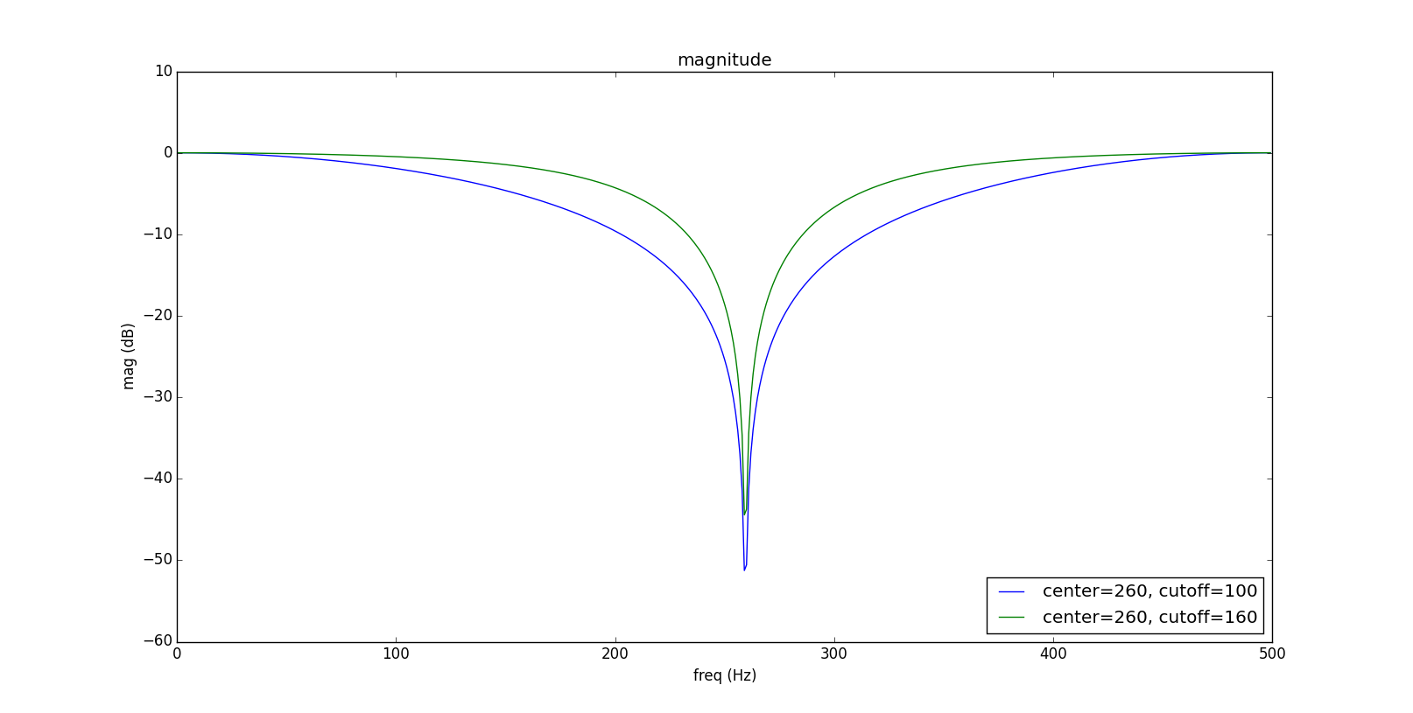
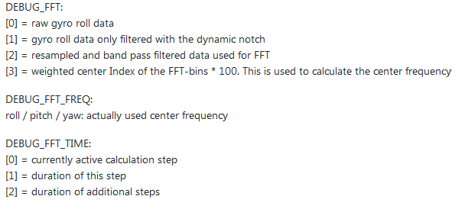
Dynamic Notch Cut Example
DEBUG_FFT:
[0] = pre-dyn notch gyro roll data
[1] = gyro roll data only filtered with the dynamic notch
[2] = resampled and bandpass filtered data used for FFT
[3] = weighted center Index of the FFT-bins * 100. This is used to calculate the center frequency
DEBUG_FFT_FREQ:
[0] = roll: notch center frequency
[1] = pitch: notch center frequency
[2] = yaw: notch center frequency
[3] = pre-dyn notch gyro roll data (to comp with debug[0])
DEBUG_FFT_TIME:
[0] = currently active calculation step
[1] = duration of this step
[2] = duration of additional steps

Slide 12
FILTER APPROACH COMPARISON

Slide 13
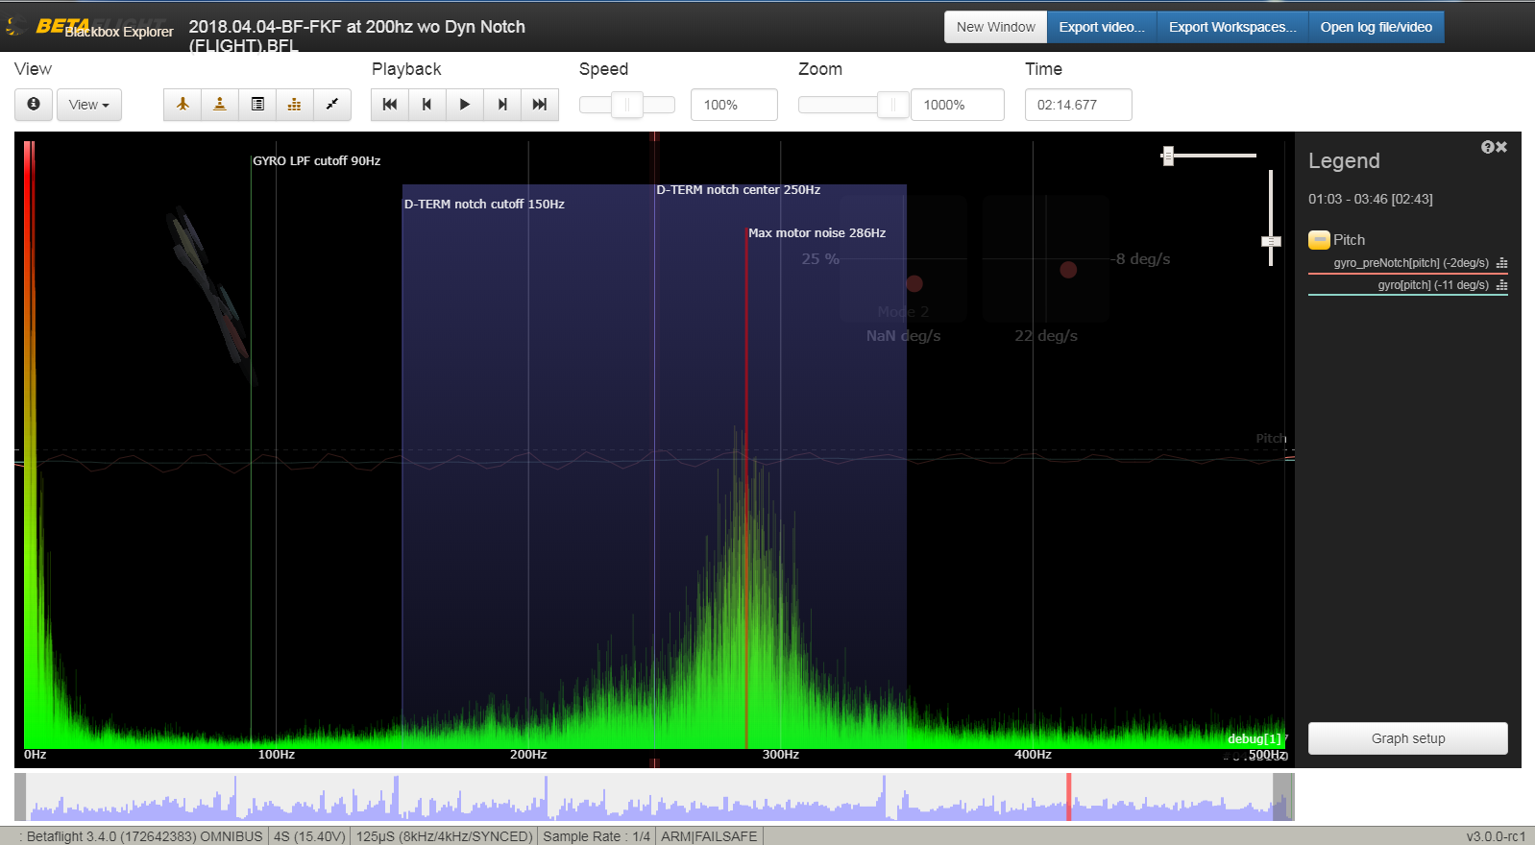
Approach 1
Noise Sample

Slide 14
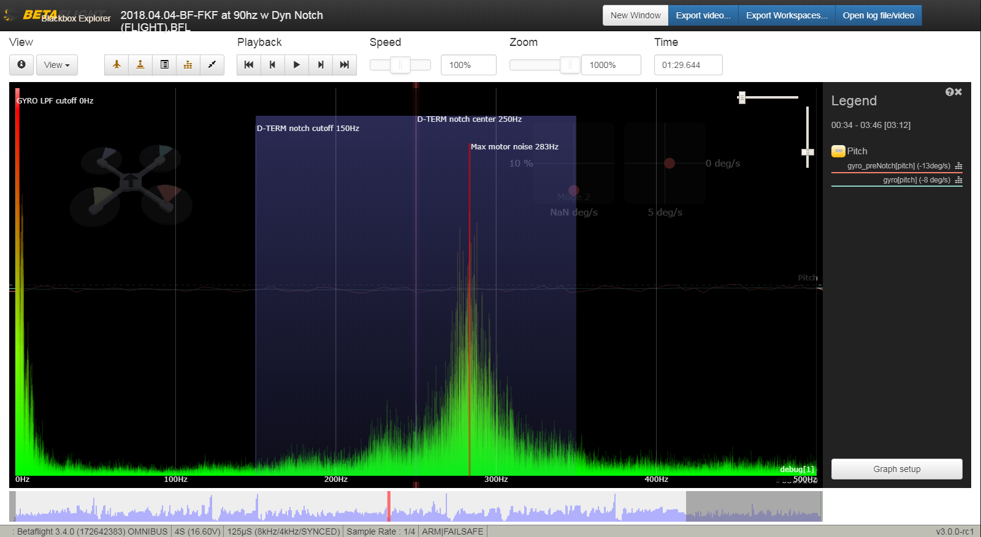
Approach 2
Noise Sample

Slide 15
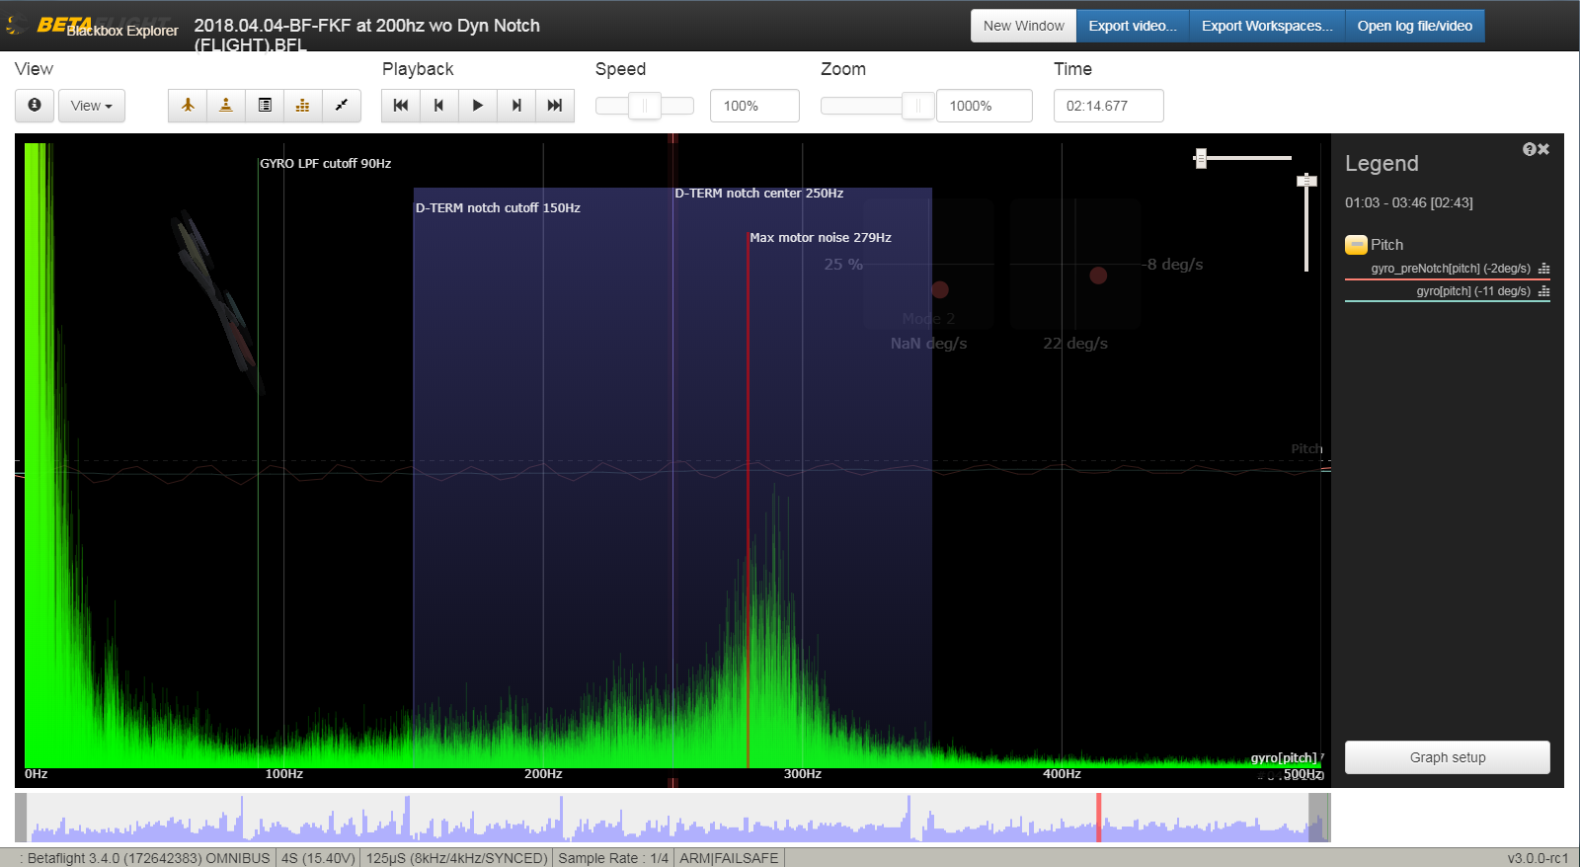
Approach 1
Post Filtering

Slide 16
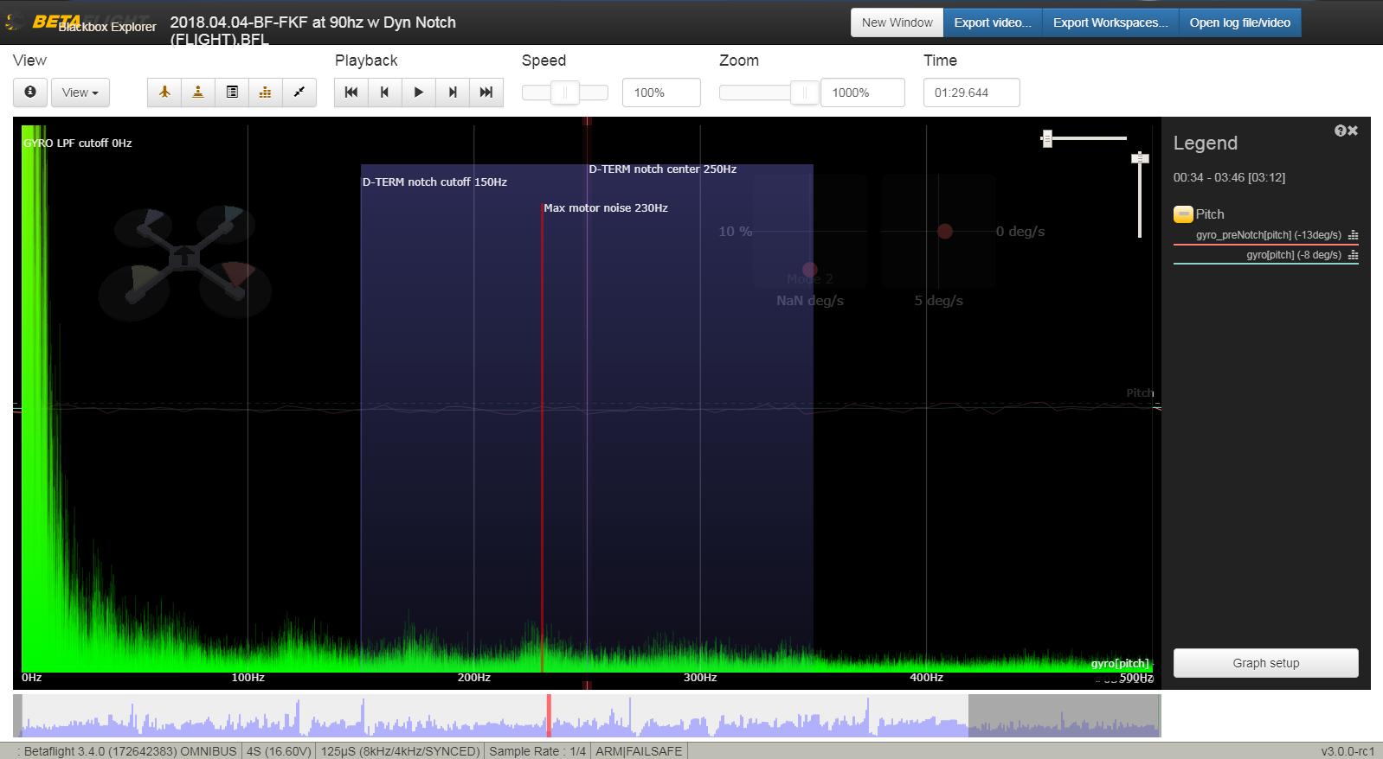
Approach 2
Post Filtering

Slide 17
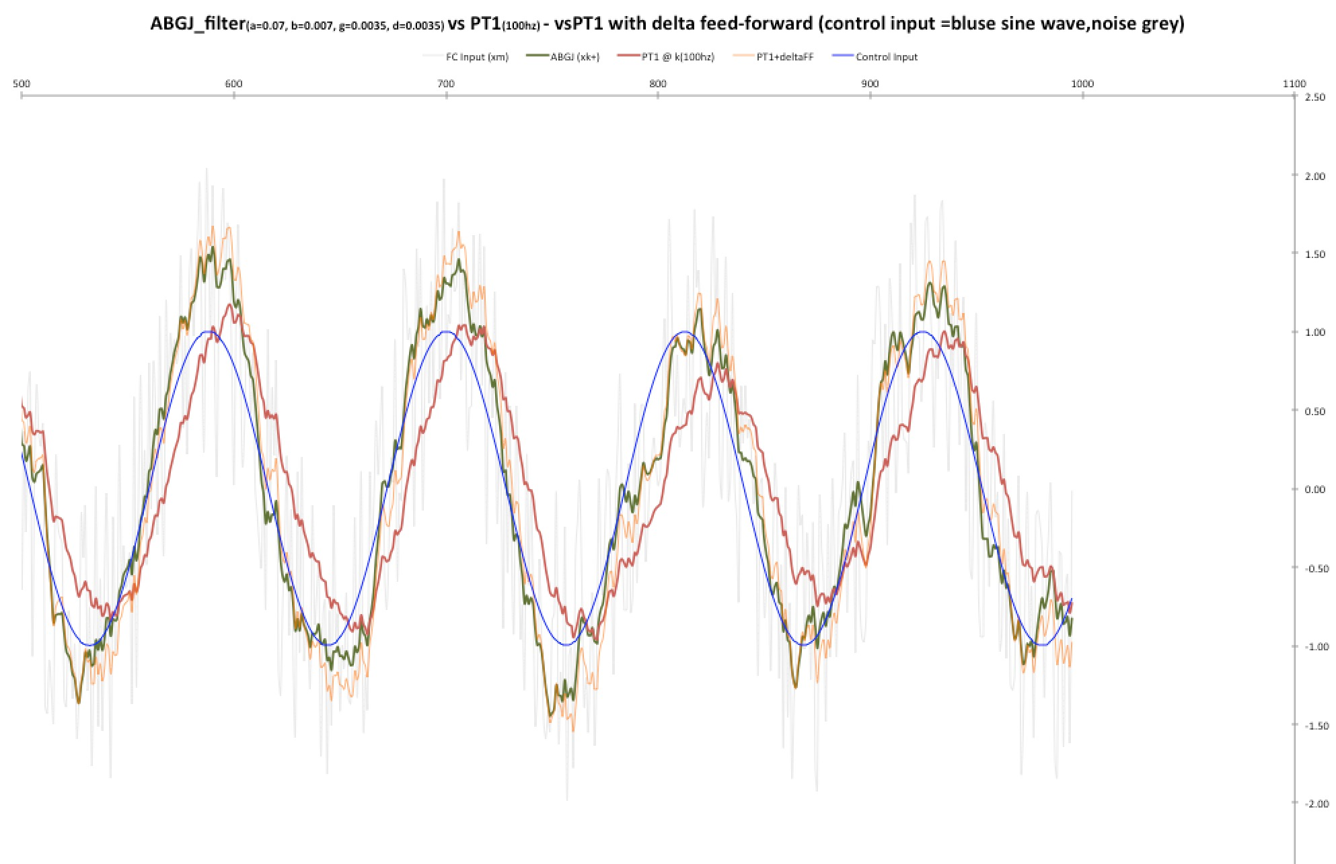

Slide 18
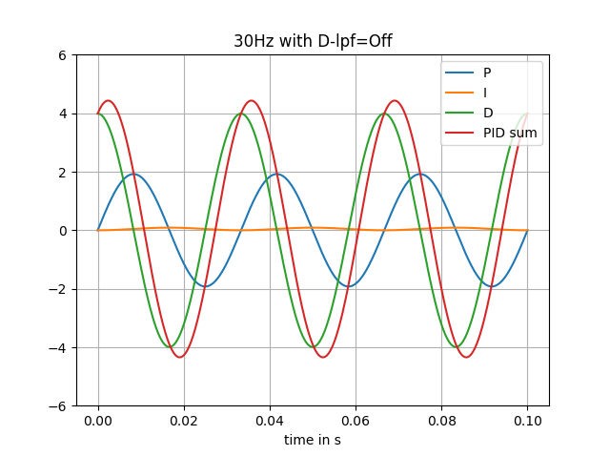
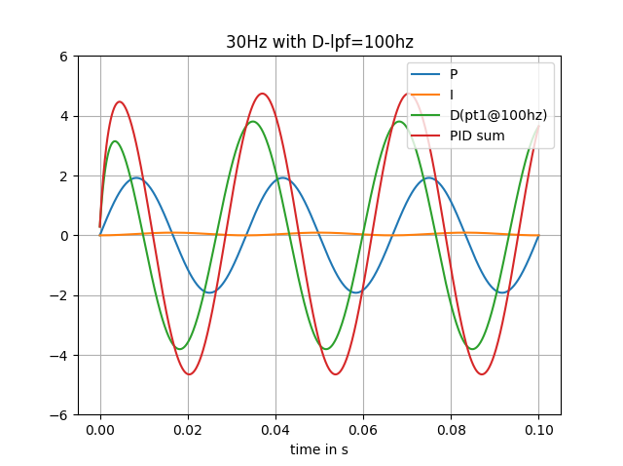

Slide 19
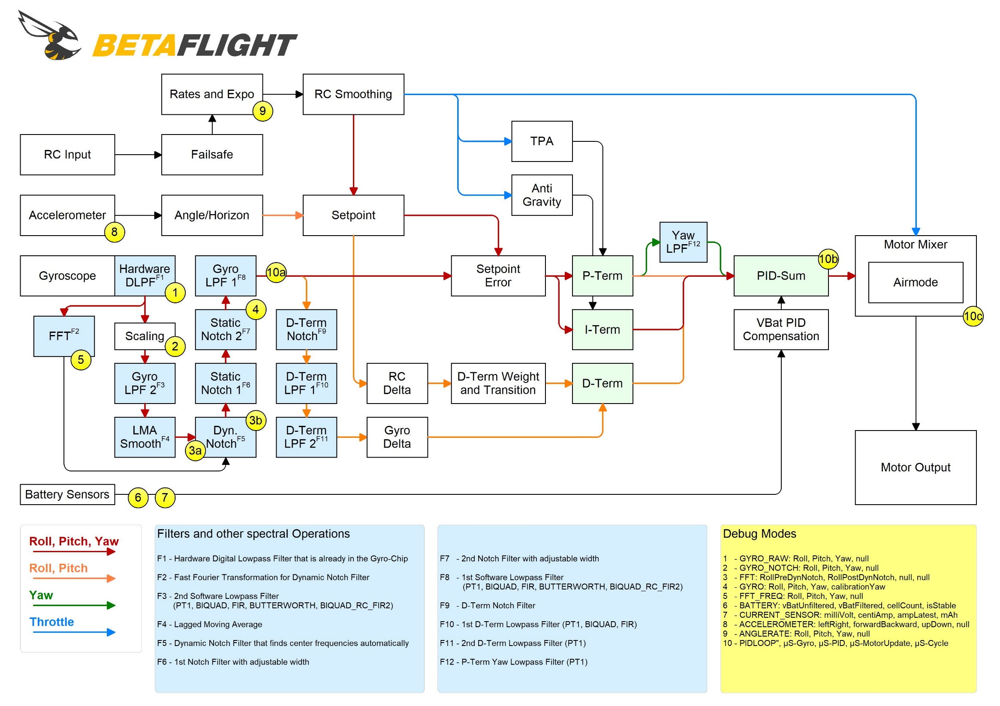

Slide 20
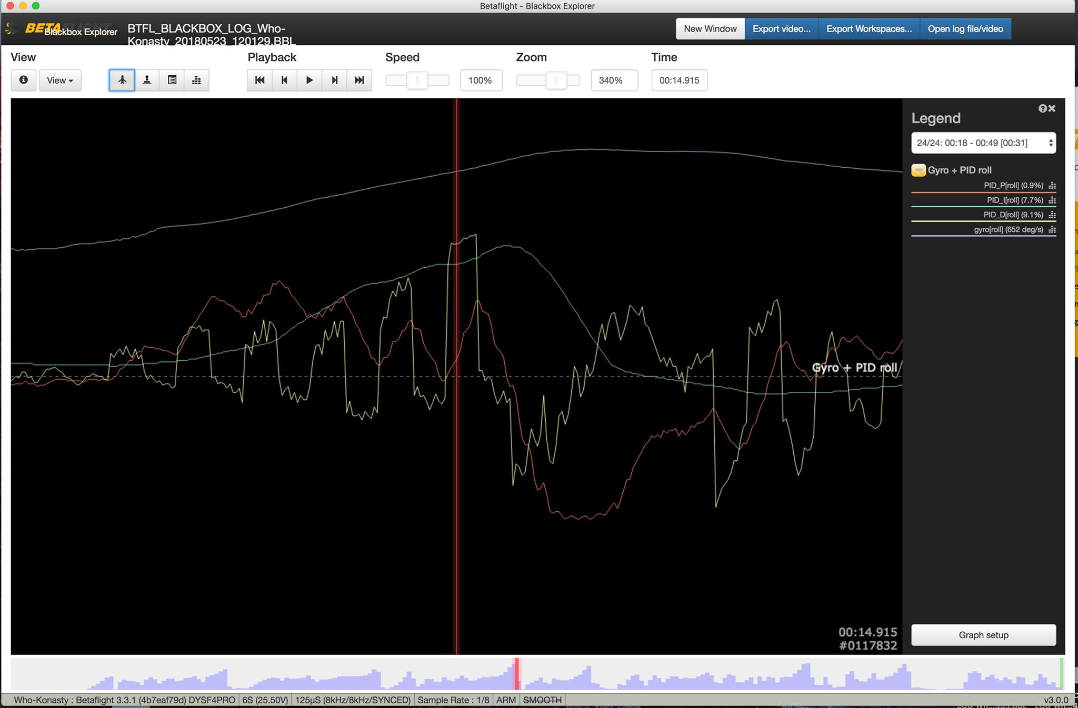

Slide 21
